Slide 1

Technical Audit Report
Provenance Hub
Discover Timeless Treasures
Team Members
24MIS1053 – Hemanth Kumar K
24MIS1040 – Vijay Mathew A
Document Type
Date
Implementation Audit
March 2026

Slide 2
Audit Overview
What This Document Covers
Core Foundational Systems
Backend State Management
Architecture patterns, routing mechanisms, and base framework implementations that power the application
PHP sessions, security implementations, authentication flows, and data persistence
Peripheral Subsystems
Architecture & Framework
Mailing infrastructure, notification systems, and external service integrations
MVC structure, component identification, technology stack mapping
UI Behavior & Frontend Logic
SEO & Implementation Audit
jQuery event handling, DOM manipulation, AJAX communication patterns
Semantic markup, meta management, accessibility, and performance optimization
Note: This audit focuses on practical implementation rather than theoretical concepts, providing actionable insights for development teams

Slide 3
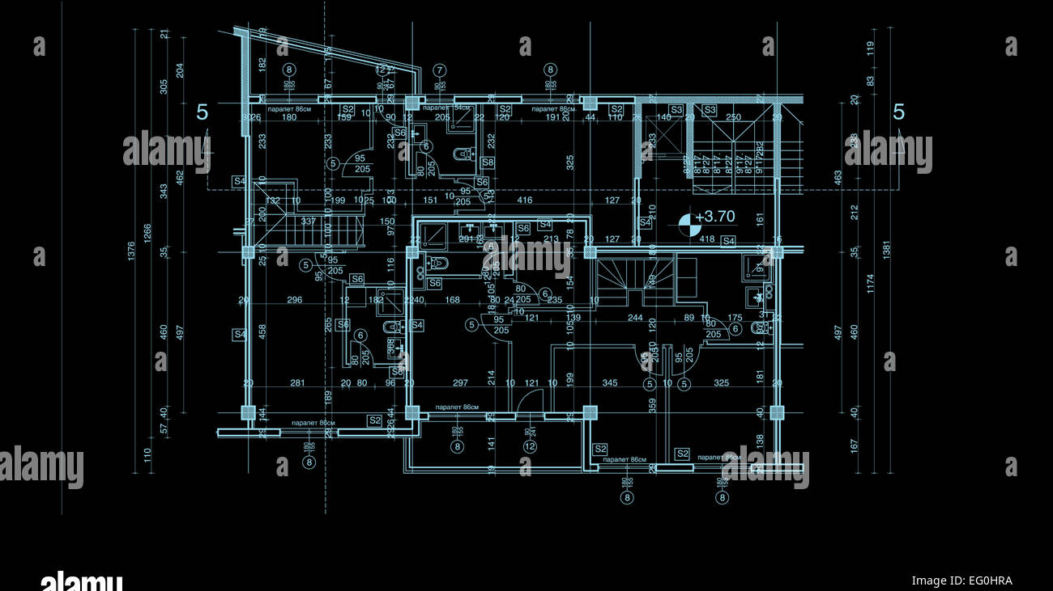
01
Part 1
Comprehensive
Implementation Audit
Maps the application's underlying code methodologies and implementation patterns
Covers both core foundational systems and peripheral subsystems
Focuses on practical implementation rather than theoretical concepts
Encompasses mailing, frontend, backend, security, architecture, and SEO
Mailing Infrastructure
Frontend Logic
Backend Systems
Security & SEO

Slide 4
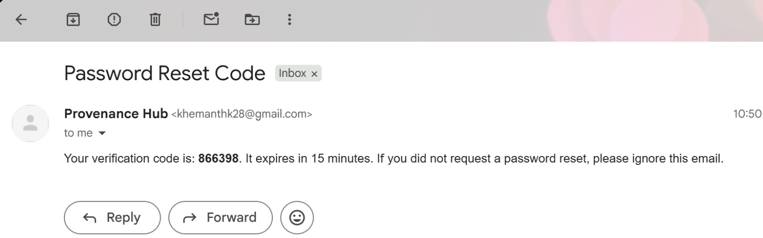
External Systems
External Systems & Integrations
Mailing & Notifications Infrastructure
PHPMailer Integration
Security Rationale
Standard PHPMailer package used as a reliable SMTP wrapper for outbound email communications
Avoids PHP native mail()
Key Implementation Benefits:
Native function lacks authentication, encryption, and proper header management—making it insecure for production use
Handles SMTP authentication gracefully
Improves email deliverability rates
Avoids spam filter triggers
SMTP Authentication
PHPMailer enables secure credential-based authentication with mail servers
Password Reset System
Visual Placeholder
Secure tokenized recovery links sent through PHPMailer infrastructure
Security Features:
Cryptographically secure token generation
Time-limited reset validity
Single-use token consumption

Slide 5
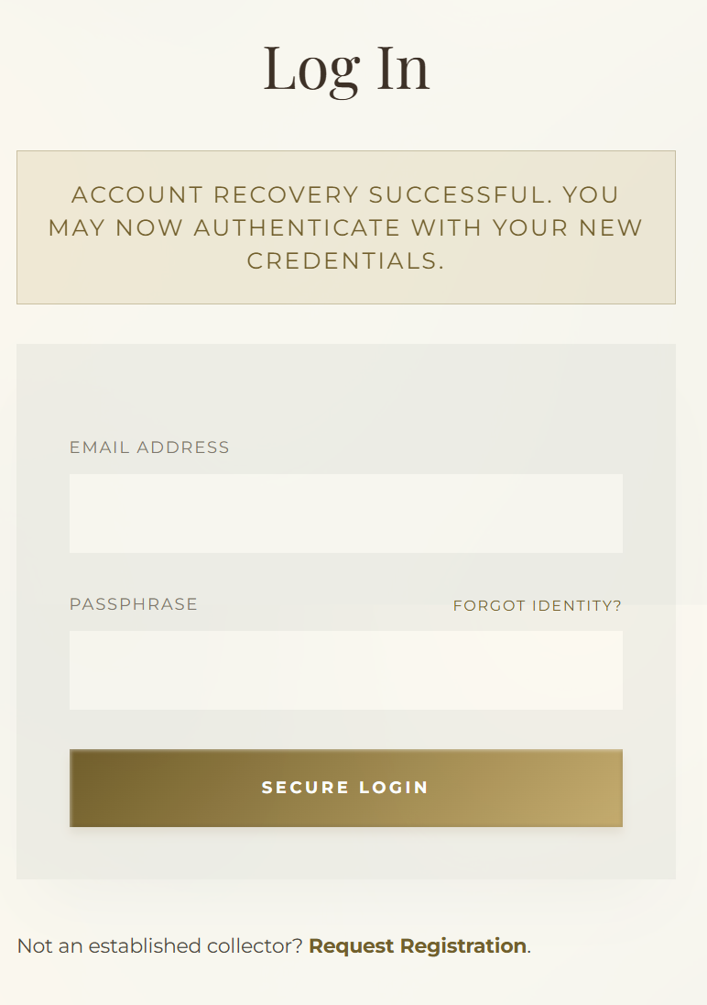
Security Flow
Password Recovery and SMTP Delivery
Key Features
Tokenized Recovery Links
Password Reset Process Flow
Single-use tokens prevent replay attacks
1
User Requests Reset
Secure Outbound Delivery
Form submission triggers token generation
SMTP encryption protects in-transit data
High Deliverability
2
Token Generation
Proper authentication avoids spam folders
Cryptographically secure token created & stored
`
3
PHPMailer Dispatch
SMTP-authenticated email with reset link sent
4
Token Verification
User clicks link; system validates token authenticity
5
Password Update
New password hashed and stored; token invalidated

Slide 6
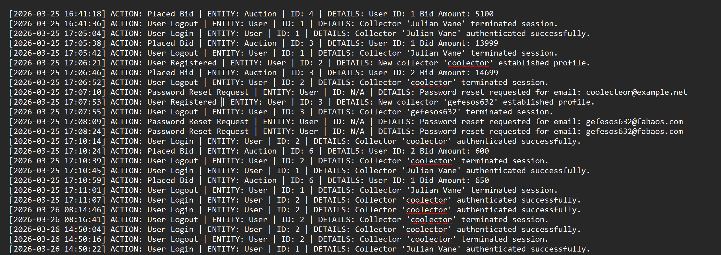
Event Tracking
Audit Logging and Background Event Tracking
Background Processing
Administrative Oversight
Background interactions are processed silently without disrupting the user experience. The system captures critical events while maintaining frontend responsiveness.
Non-Intrusive Logging
Writes directly to database without blocking frontend UX
Implementation Method
Audit Trail
logAction()
Complete historical record for compliance and debugging
Captures user registrations and logins
Records timestamped events to database
Security Monitoring
Track suspicious activities and unauthorized access attempts
Database Schema
user_id
Identifies the actor
action_type
Event classification
description
Detailed event context
timestamp
When event occurred
Note: Event logging operates asynchronously to ensure zero impact on user-facing response times

Slide 7
Frontend Logic
jQuery Events and Event Delegation
Event Delegation Pattern
Why Event Delegation?
Memory Efficiency
Implementation
Single listener handles all matching elements
$(document).on('click', '.place-bid-btn')
Dynamic Content Support
New elements automatically inherit behavior
This pattern binds event listeners to the document root, ensuring dynamically rendered buttons remain functional without re-initialization.
Performance
Keeps dynamically rendered buttons bound
Reduces DOM manipulation overhead
Eliminates need for re-initialization after DOM updates
Ensures interactive controls work after AJAX content loads
Best Practice: Event delegation is the recommended pattern for applications with dynamic content
File Locations
assets/js/app.js
Primary event delegation implementation
header.php
Global mousedown ripple mechanics

Slide 8
UI Animation
jQuery Effects and UI Animation
Animation Effects
Bid Transition Sequence
1
Current Price Display
fadeIn
&
fadeOut
Visible bid amount shown to user
Smooth opacity transitions in submitBid function
Animation Queue
2
fadeOut Effect
Old price gracefully disappears
Sequential effect execution ensures visual coherence
3
fadeIn New Price
Visual Feedback Benefits
Updated winning bid appears
Hides old bid price gracefully
Slides in newly calculated winning bid
Improves perceived responsiveness
Reduces cognitive load during transactions

Slide 9

DOM Operations
UI State Transitions
DOM Manipulation in the Bid Workflow
Place Bid
Initial state; button active and clickable
jQuery DOM Methods
Processing
html()
text()
AJAX request in progress; UI shows loading state
Set inner HTML
Set text content
Bid Placed Successfully
addClass()
removeClass()
Confirmation shown; price updated
Add CSS class
Remove CSS class
These methods are used in submitBid logic to directly manipulate visual state and provide immediate user feedback.
Network Error
Error message displayed; retry option available
Implementation Context
Primary Function
submitBid
Handles bid submission workflow with real-time UI updates

Slide 10

DOM Navigation
Nested DOM Traversal and Context Isolation
Traversal Methods
Implementation Example
closest()
Pattern from app.js
Traverses up the DOM tree to find the nearest matching ancestor
btn.closest('.bid-container')
.find('.current-price')
find()
Searches through descendants to locate matching elements
Step 1: Start from clicked button
Step 2: Traverse up to bid container
Context Isolation Benefits
Step 3: Search down for price element
Isolates nested structural contexts
Targets correct bid container
Prevents selector collisions
Supports multiple bid containers on same page

Slide 11
Data Exchange
JSON Creation and Serialization
PHP-Driven JSON Generation
Structured Output Benefits
JSON creation is driven natively through PHP controllers. API endpoints build structured arrays and return data using standard PHP serialization methods.
Frontend Communication
Supports seamless data exchange with JavaScript
Core Method
Standard Format
echo json_encode($dataArray);
Industry-standard JSON for interoperability
Type Safety
Preserves data types during serialization
Key API Endpoints
ApiController::placeBid
Handles bid placement responses
searchSuggestions
Returns search autocomplete data

Slide 12

Request/Response Flow
Async Operations
Asynchronous Networking with $.ajax
User Action
Click triggers JavaScript event
$.ajax as Core Mechanism
$.ajax Request
$.ajax is the focal mechanism for asynchronous communication between frontend and backend. It handles high-risk transactions while maintaining responsive user interfaces.
Async POST to API endpoint
Key Capabilities
Server Processing
Sends payloads directly to backend logic
PHP controller handles logic
Avoids browser reloads during operations
Supports smooth user interaction
JSON Response
Data returned; UI updates
Performance Benefits
No Page Reloads
Responsive UI
Partial Updates
Error Handling

Slide 13
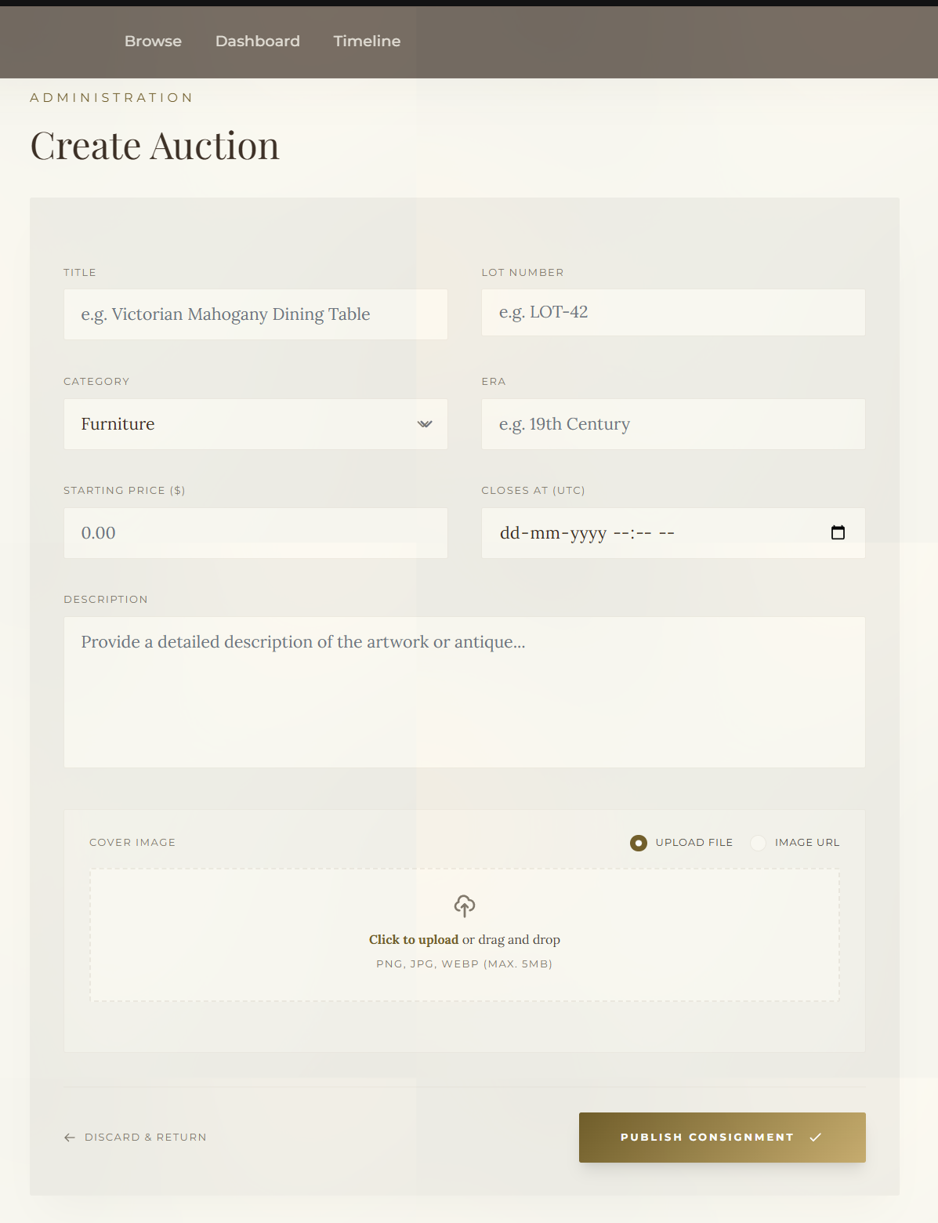
Form Processing
File Upload Workflow
File & Form Handling
$_FILES Superglobal
Accesses uploaded file metadata and temporary storage
Structural Validation
Validates file type, size, and structural integrity
Path Verification
Ensures destination directory exists and is writable
move_uploaded_file()
Securely relocates file from temp to permanent storage
Controller Implementation
Primary Handler
AdminController::store()
Processes multipart form submissions with file upload support

Slide 14
Error Handling
Upload Processing and GD Fallbacks
Robust Upload Handling
Fallback Flow
Upload handling is designed to be robust and defensive, gracefully handling missing dependencies and server configuration variations.
1
Upload Received
File passes initial validation
Defensive Design Principles
Cleanly bypasses missing GD libraries
2
Check GD Availability
Maintains uptime on servers without GD
extension_loaded('gd') test
Supports safe file relocation
Ensures admin workflows continue
GD Available
GD Missing
Process with compression
Skip to direct move
GD Library Context
Upload Complete
GD Library: PHP extension for image processing (resizing, compression, format conversion)
File saved successfully
The system detects GD availability and adjusts functionality accordingly, ensuring core upload features remain operational.

Slide 15


State Management
Role-Based Access Flow
PHP State Management with Sessions
User Login
Session populated with credentials
Session Initialization
Role Detection
Sessions are initiated at the top of the runtime application, establishing the foundation for all state-dependent operations.
$_SESSION['role'] determines access
Session Superglobals
Collector Role
Admin Role
$_SESSION['user_id']
→ Collector Dashboard
→ Admin Panel
Identifies authenticated user
$_SESSION['role']
Defines user permissions
1
Routing Controllers
PageController
Primary routing logic based on session state
AuthControllers
Authentication and authorization handlers

Slide 16
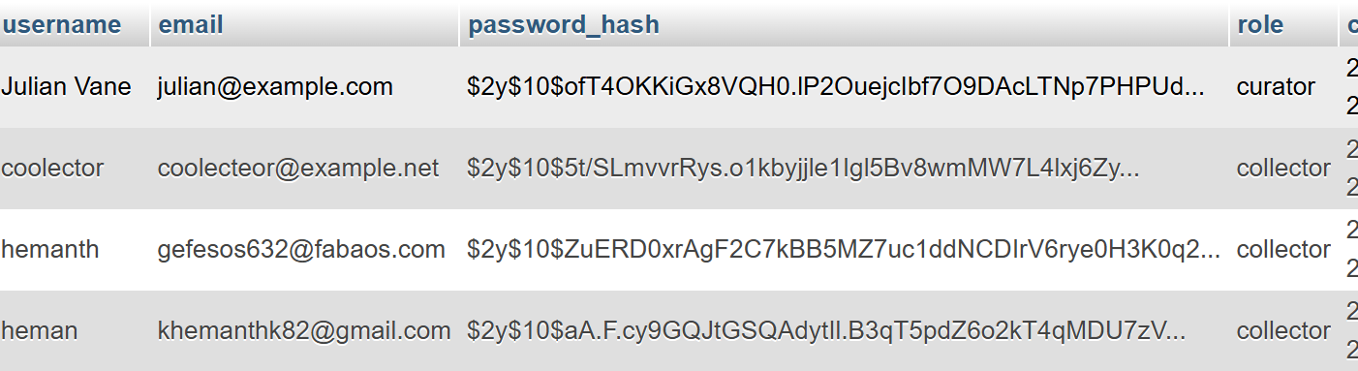
Security Layer
Security Operations: Hashing and Tokenization
Password Hashing
CSRF Protection
password_hash()
Token Storage
Creates secure password hash using bcrypt algorithm
$_SESSION['csrf_token']
password_verify()
Token Rotation
Securely verifies password against stored hash
Tokens rotate to ensure form integrity
Form Protection
Algorithm: bcrypt with automatic salt generation
Validates token on POST submissions
Security Benefits
One-way hashing prevents password recovery
Automatic salt prevents rainbow table attacks
Adaptive cost factor slows brute force
Standard: Implements OWASP-recommended security practices

Slide 17
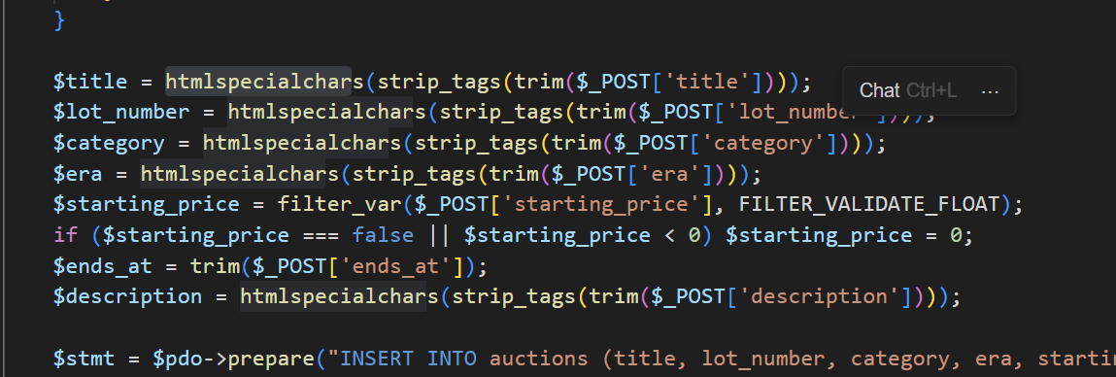
Input Security
Sanitization and Output Security
Input Sanitization
Protection Layers
SQL Injection Defense
filter_var($url, FILTER_SANITIZE_URL)
PDO prepared statements with parameter binding
URL string sanitization for safe redirects
XSS Prevention
htmlspecialchars() escapes output in all views
PDO Assignments
Strict PDO parameter binding for all user inputs (excluding passwords)
URL Validation
filter_var() sanitizes redirect parameters
Output Escaping
htmlspecialchars($output)
Applied across all .php view templates to prevent XSS execution
Result: Rendering is made safer across all view templates

Slide 18
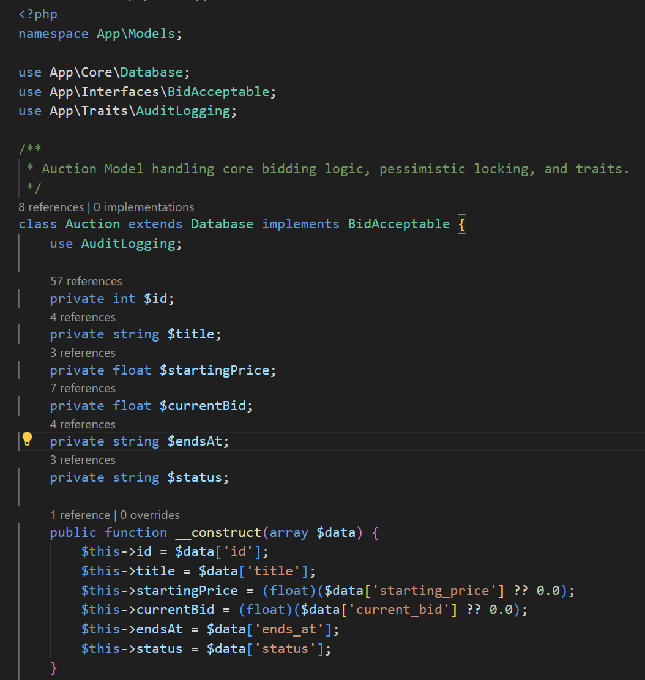
Advanced Implementation
Static Execution
PHP Advanced Features (OOP, Namespaces, Seeding)
Auction::findById()
Database Seeding
Static factory method used strategically for efficient model retrieval without instantiation overhead
Seeding Script
database/seed.php
Reduces object instantiation overhead
Provides clean API for common queries
Uses raw PDO to format structural schemas and load initial testing data
Encapsulates query logic in model
Seeding enables rapid environment setup with consistent test data for development and staging environments.
Namespace Architecture
App\ namespace
PSR-4-esque autoloading configured
Collision Prevention
Separates App\Controllers from App\Core

Slide 19
System Architecture
Architecture Overview and Framework Identifications
MVC Architecture
Technology Stack
Rigid Custom Model-View-Controller (MVC) architecture with centralized Front-Controller Routing mechanism.
TailwindCSS v3
Via CDN with dynamic tailwind.config
Entry Point
index.php
jQuery 3.7.1
Frontend JavaScript library
All incoming traffic routes through central front controller
PHPMailer
Backend email utility
Layer Breakdown
MySQL + PDO
Database with singleton pattern
Presentation Layer
.php template views with HTML layouts
Interaction Layer
Vanilla JavaScript and lightweight jQuery
Persistence Layer
MySQL with Database.php and PDO singletons

